Slide 1
An Update on International Global Environmental Change Research Activities: Belmont Forum and IGFA GEO- EGIDA Meeting May 10, 2011 Maria Uhle Program Director for International Activities Directorate for Geosciences

Slide 2
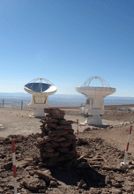
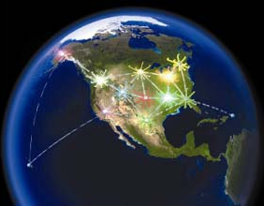
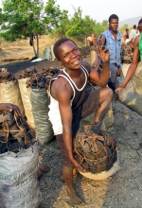
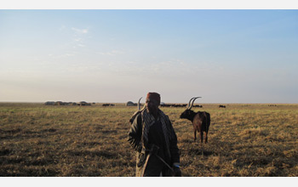
Current international GEC research landscape
Complex landscape with inter-related research programs and strategies
ICSU, ESSP, WCRP, IGBP, IHDP, START
Regional research programs IAI, APN, AfricaNESS
Bilateral agreements – e.g., European Commission

Slide 3
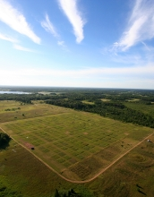
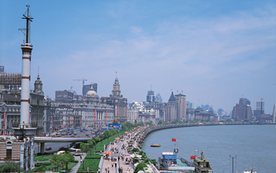
ICSU & IGFA reviews of international GEC programs
Concluded: we all face new GEC challenges and need to…
Build upon existing strong foundation of global change research
Deliver knowledge to enable sustainable economic development, poverty alleviation and environmental protection
Deepen understanding of the earth system and human impacts
Notes:
3

Slide 4
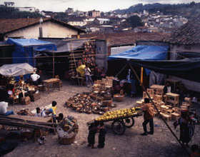
ICSU & IGFA reviews of international GEC programs
Build capacity to deliver solutions to global and regional sustainability challenges
Significantly expand the involvement of social scientists and economists in research agenda
Adopt research approaches that actively involve stakeholders and decision-makers
Effectively deliver end-to-end environmental services
“Business as usual is not an option. Current global research arrangements are unable to adequately meet new GEC challenges…”.
Notes:
4

Slide 5
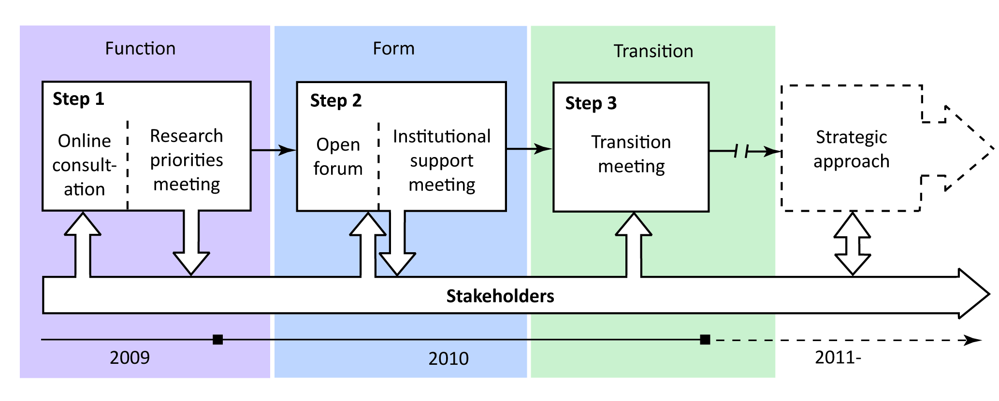
International efforts to meet the GEC challenges…
ICSU began Visioning Process and identified “Grand Challenges” in 2009 (updated in 2010)
Better coordination of GEC programs, resources, priorities

Slide 6
ICSU identified 5 “Grand Challenges”
Forecasting: Improve the usefulness of forecasts of future environmental conditions and their consequences for people.
Observing: Develop, enhance and integrate the observations systems needed to manage global and regional environmental change.
Confining: Determine how to anticipate, avoid and manage disruptive global environmental change.
Responding: Determine what institutional, economic and behavioral changes can enable effective steps toward global sustainability.
Innovating: Encourage innovation in developing technological, policy, and social responses to achieve global sustainability.

Slide 7
International research funding agencies - efforts to meet the GEC challenges…
International Group of Funding Agencies for Global Change Research (IGFA)
Forum for funding agencies, long history, 20+ years
Belmont Forum
Small group of national funding agencies - subset of IGFA
Established 2009 by US & UK
Charter members – large global climate research funding agencies: USA (NSF, co-lead), UK (NERC, co-lead), Australia (DCC), Canada (NSERC), France (CNRS), Germany (BMBF), Japan (MEXT)
(http://www.igfagcr.org/index.php/belmont-forum)

Slide 8
The Belmont Challenge
To deliver knowledge needed for action to mitigate and adapt to detrimental environmental change and extreme hazardous events.
This requires:
Information on the state of the environment, through advanced observing systems;
Assessments of risks, impacts and vulnerabilities, through regional and decadal analysis and prediction;
Enhanced environmental information service providers to users;
Inter- and transdisciplinary research which takes account of coupled natural, social and economic systems;
Effective integration and coordination mechanisms, to address interdependencies and marshal the necessary resources.
With priority foci being:
Coastal Vulnerability
Freshwater Security
Ecosystem Services
Carbon Budgets
Most vulnerable societies

Slide 9
Belmont Forum Requests ICSU Study What does it take to meet the Belmont Challenge?
ICSU’s recommendations to funding agencies include:
Develop Earth System knowledge
Develop and coordinate advanced experimental, observational, computational facilities
Develop integrated Earth system models
Facilitate communication of knowledge to decision makers
Nurture next generation of experts
(Report released August 2010)

Slide 10
Belmont Forum Evolution
The Belmont Forum is now the “Council of Principals” for IGFA - with the goal of reinvigorating IGFA
Engage global and regional environmental change research programs (e.g., IAI, START, WCRP, IGBP)
Current Members
Austria
Australia
China
European Commission
Brazil
Canada
France
Germany
Norway
South Africa
United Kingdom
United States
International Council for Science (ICSU)
International Social Sciences Council (ISSC)

Slide 11
International efforts to enhance cooperation
ICSU Visioning process – research focus on sustainability with an end-to-end approach; new international structure to involve social sciences and end-users in research development
Belmont Forum & Re-energized IGFA – research focus on Belmont Challenge - mitigate and adapt to detrimental environmental change and extreme hazardous events – through advanced observing systems; regional and decadal analysis and prediction; inclusion of service providers and user communities; natural, social and economic systems research
ICSU, Belmont and IGFA combined their efforts
11
Notes:
Strategic partnership of willing stakeholder representatives of the international global environmental change research community, funders, operational service providers, and users, with formal backing of their constituents, who share a common goal to meet the challenges of global environmental changes through a new co-designed and co-delivered initiative.
11

Slide 12
A New Way Forward: A Proposed “Alliance”
Emerging strategic partnership among scientists, funders, operational service providers and end-users seeking sustainable solutions to GEC
New co-designed and co-delivered 10-year Initiative for Global Environmental Change Research for Sustainability in 2012
Launch at Planet under Pressure, March 2012 and Rio+20, June 2012

Slide 13
The “Alliance” and its 10 - Year Initiative
Funding
Agencies
Research
Community
Users
Operational
Service
Providers
GEO-GEOSS
Belmont Forum
ICSU and ISSC
?
Eg.
WMO/UNEP
Earth System Research for Global Sustainability
Single overarching strategy
‘Transition Team’ leads 18 month design phase
Replaced by permanent Board
Coastal
Vulnerability
Freshwater
Security
Ecosystem
Services
Carbon
Cycling
Vulnerable
Societies
CRAs
Observing
Forecasting
Confining
Responding
Innovating

Slide 14
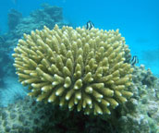
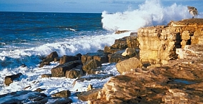
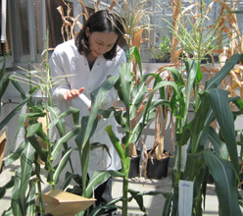
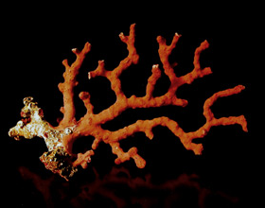
Next Steps for the Belmont Forum
Focus on aligning resources and funding opportunities for international partnerships
Supplements to existing grants
Pointing to partner country’s solicitations in research announcements (France, Germany & UK)
Belmont Forum Opportunities Funds
NSF GEO to spearhead workshops on water sustainability and coastal vulnerability in early to mid-autumn

Slide 15
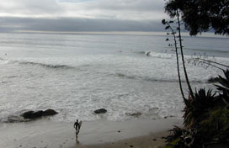
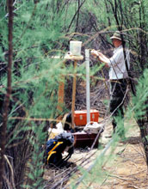
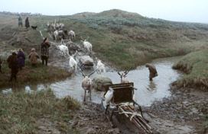
Workshop Overview
Workshop for grantees and program officers of BF member countries to:
Research priorities for international collaboration for water sustainability and coastal vulnerability
Lessons learned from previous collaboration
Develop awareness of each others systems
Encourage program collaboration
Develop mechanisms to support co-aligned projects
Workshop to be held in early to mid-autumn

Slide 16
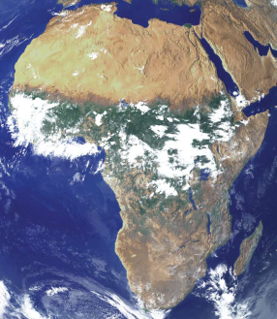
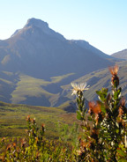
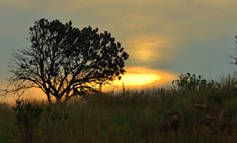
Next Steps for IGFA
Chair – Tim Killeen Co-Chair – Kevin Noone – SSEESS
Focus on developing countries and regional cooperation – Africa current focus
Focus on activities to engage research funding agencies and development aid agencies
SSEESS is working with Sida
Implementation of AfricaNESS science plan
Krusenberg II
A Strategy for Global
Environmental Change
Research in Africa
Science Plan and
Implementation Strategy

